Slide 1

DataBase’s checkpoint
Zouhour Bahri

Slide 2
RDBMS Definition:
RDBMS stands for Relational DataBase Management System : is the most popular type of DataBase Management System (DBMS) in 2020 since the most used database management systems are relational like:
Oracle, MySQL, PostgreSQL and SQL SERVER.
An RDBMS is a particular type of DBMS that uses a relational model for its databases. An RDBMS therefore enables you to create relational databases.

Slide 3
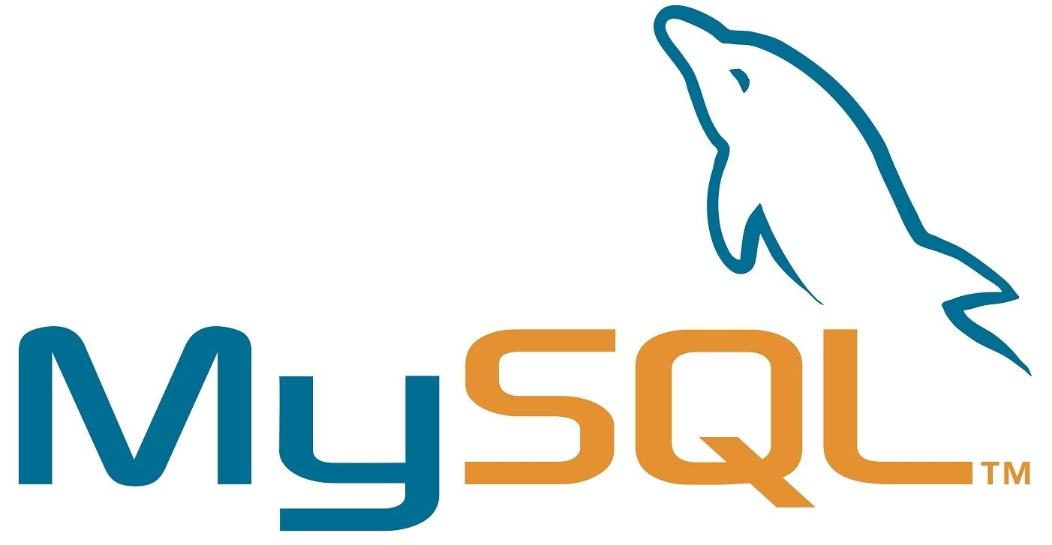
MySQL
MySQL is one of the most popular open source SQL database. It was developed by a Swedish company – MySQL AB.
It is typically used for web application development, and often accessed using PHP.
The main advantages of MySQL are that it is easy to use, inexpensive, reliable (has been around since 1995), and has a large community of developers who can help answer questions.

Slide 4
Functionalities
Management Ease: It is pretty easy to download and use the software.
High performance : It provides you fast loading utilities with different memory cache.
Scalability and adaptability: It is really easy to create data warehouses including an enormous amount of data.
Compatibility : MySQL is compatible with all modern platforms like Windows, Linux, Unix.
Performance : MySQL gives you high performance results without losing essential functionality.
Complete Data Security : Only the authorized users can access the database. Complete security for the data.
Lowest Total price of ownership.
Memory Efficiency : MySQL has low memory leakage.

Slide 5
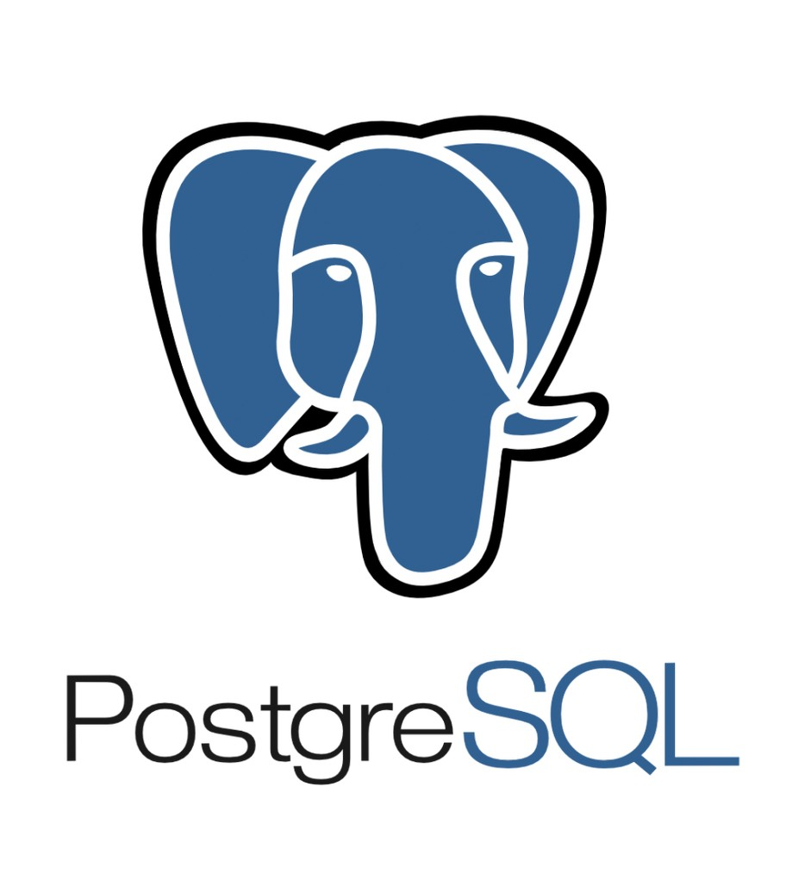
PostgreSQL
POSTGRESQL is an advanced, enterprise class open source relational database that supports both SQL and JSON querying. It is a highly stable database management system, backed by more than 20 years of community development which has contributed to its high levels of resilience, integrity, and correctness. PostgreSQL is used as the primary data store or data warehouse for many web, mobile, geospatial, and analytics applications. The latest major version is PostgreSQL 12.

Slide 6
Functionalities
Free: Free To download compatibe on several operation systems, compatible with various programming languages.
Compatible with Data Integrity: Primary Keys, UNIQUE, NOT NULL, Foreign Keys, Explicit Locks, Advisory Locks, Exclusion Constraints.
Supports multiple Indexing such as Multicolumn, Partial, B-tree, and expressions.
Supports transactions, Nested Transactions through Save points.
Just-in-time compilation of expressions.
Table partitioning.
Secure: It is safe because it follows several security aspects.
It supports different types of Replication like Synchronous, Asynchronous, and Logical.
PostgreSQL supports Column and row-level security.

Slide 7

SQL Server
SQL SERVER is a relational database management system (RDBMS) developed by Microsoft.
Its primary query languages are :
T-SQL
ANSI SQL

Slide 8
Functionalities
Better security
With Always Encrypted, Row-Level Security, and Dynamic data masking.
Higher availability
Including AlwaysOn Availability Groups, Cloud Witness, Storage Spaces Direct, Workgroup clusters.
Improved database engine.
TempDB enhancements, Query Store, Stretch Database.
More analytics.
Tabular enhancements, R integration).
Various improvements to reporting.
Search, custom branding, optimization for modern browsers, mobile, etc

Slide 9
Comparing
Name | Microsoft SQL Server | MySQL | PostgreSQL
Description | Microsofts relational DBMS | Widely used open source RDBMS | Widely used open source RDBMS
Primary database model | Relational DBMS | Relational DBMS | Relational DBMS
Secondary database models | Document store Graph DBMS | Document store | Document store
Developer | Microsoft | Oracle | PostgreSQL Global Development Group
Initial release | 1989 | 1995 | 1989
License | commercial | Open Source | Open Source
Implementation language | C++ | C and C++ | C
Server operating systems | Linux Windows | FreeBSD / Linux / OS X Solaris / Windows | FreeBSD / HP-UX / Linux NetBSD / OpenBSD / OS X Solaris / Unix / Windows

Slide 10
Comparing
Name | Microsoft SQL Server | MySQL | PostgreSQL
Data scheme | yes | yes | yes
XML support | yes | yes | yes
SQL | yes | yes | yes
Supported programming languages | C# / C++ / Delphi / Go / Java JavaScript (Node.js) PHP / Python / R / Ruby / Visual Basic | Ada / C / C# / C++ D / Delphi / Eiffel Erlang /Haskell / Java JavaScript (Node.js) Objective-C / OCaml Perl / PHP / Python Ruby / Scheme / Tcl | .Net / C C++ Delphi Java JavaScript (Node.js) Perl / PHP / Python Tcl

